Slide 1

Comparative Analysis of Relational and Non-Relational Databases

Slide 2

Introduction
This presentation provides a comparative analysis of relational and non-relational databases. We will explore their characteristics, use cases, and advantages to understand their applications in modern data management

Slide 3

Relational Databases Overview
Relational Databases Overview
Relational databases are structured to store data in tables with predefined
Schemas. They utilize SQL for querying and ensure data integrity through
ACID properties, making them suitable for complex transactions.

Slide 4

Non-Relational Databases Overview
Non-relational databases, often called NoSQL, are designed for flexibility and scalability.
They can store data in various formats such as documents, key-value pairs, or graphs, allowing for dynamic data

Slide 5

Key Characteristics
Relational databases emphasize structured data and
relationships, while non-relational databases focus on flexibility and scalability.
Understanding these characteristics helps in selecting the right database for specific needs.

Slide 6

Use Cases for Relational Databases
Relational databases are ideal for applications requiring transactional integrity, such as banking systems and enterprise resource planning (ERP).
They excel in scenarios where data relationships are crucial.

Slide 7

Use Cases for Non-Relational Databases
Non-relational databases are well-suited for big data applications, real-time analytics, and content management systems.
Their ability to handle diverse data types makes them popular in web and mobile applications.

Slide 8

Advantages of Relational Databases
The main advantages of relational databases include data integrity, structured querying with SQL, and robust transaction support.
These features are essential for applications that require precise data management.

Slide 9

Advantages of Non-Relational Databases
Non-relational databases offer high scalability, flexibility in data modeling, and the ability to handle large volumes of unstructured data.
These benefits cater to modern applications needing rapid growth and adaptability.

Slide 10

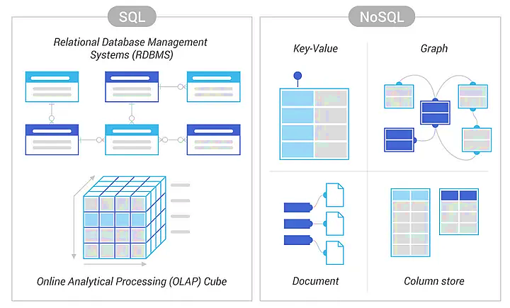
Relational Database Management System (Sql) vs Non – Relationship Database (NoSql)

Slide 11
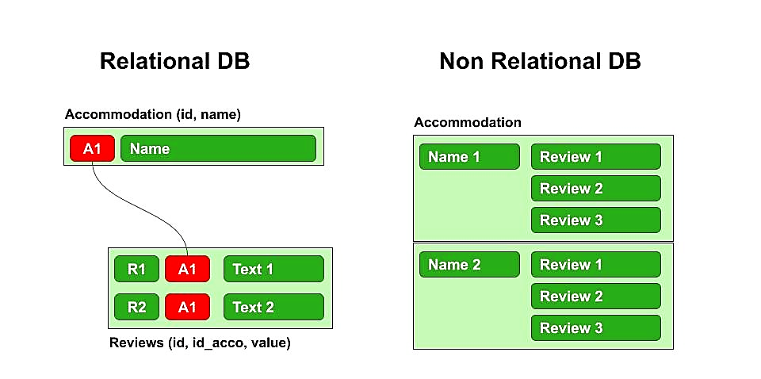
Relational DB vs Non Relational DB

Slide 12

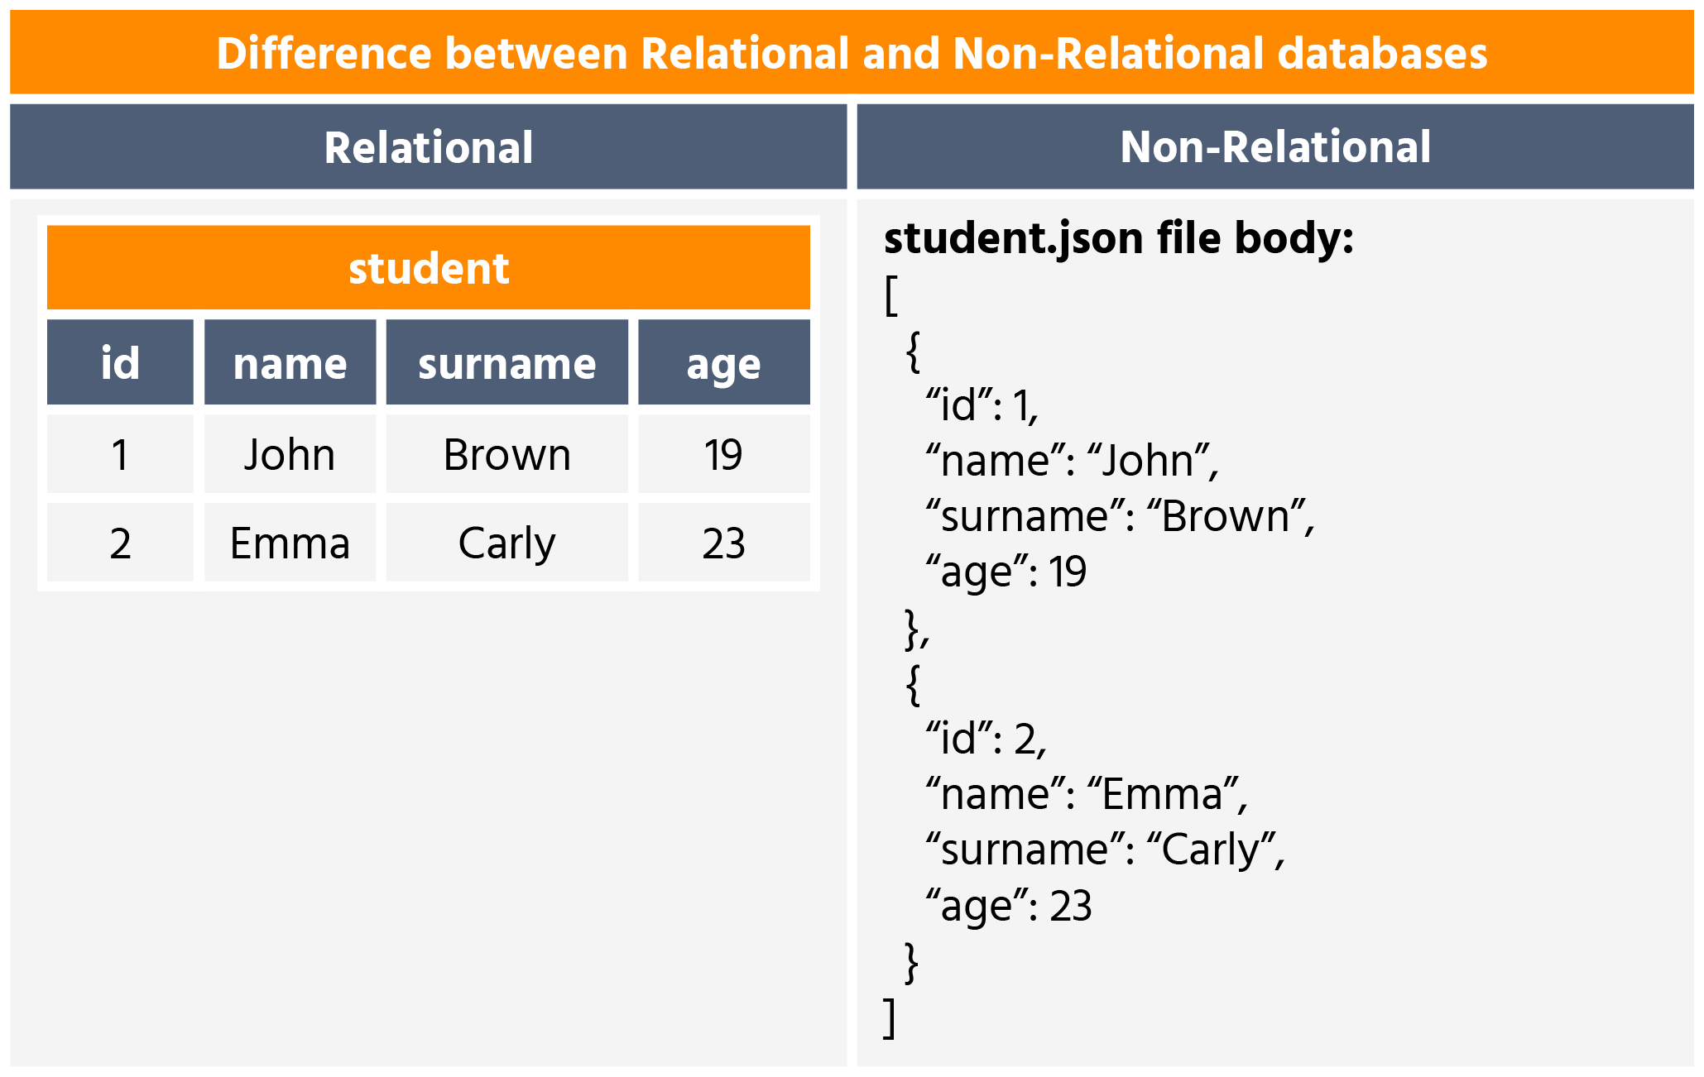
Difference between Relational and Non- Relational Databases

Slide 13
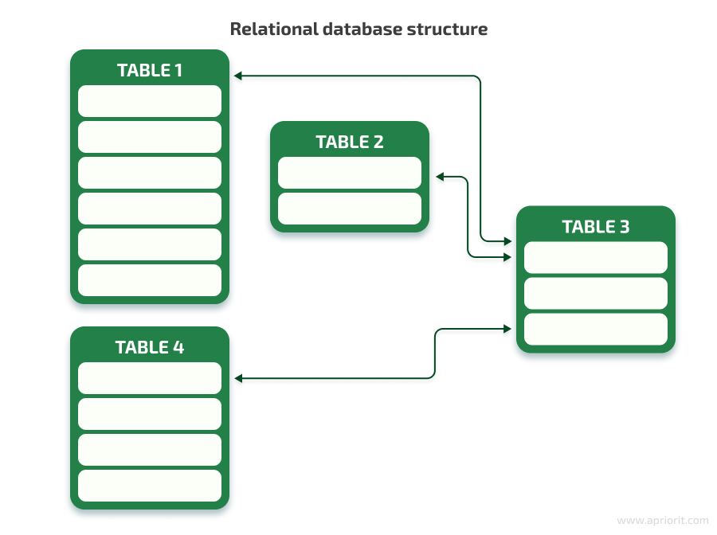
Relational data base Structure

Slide 14
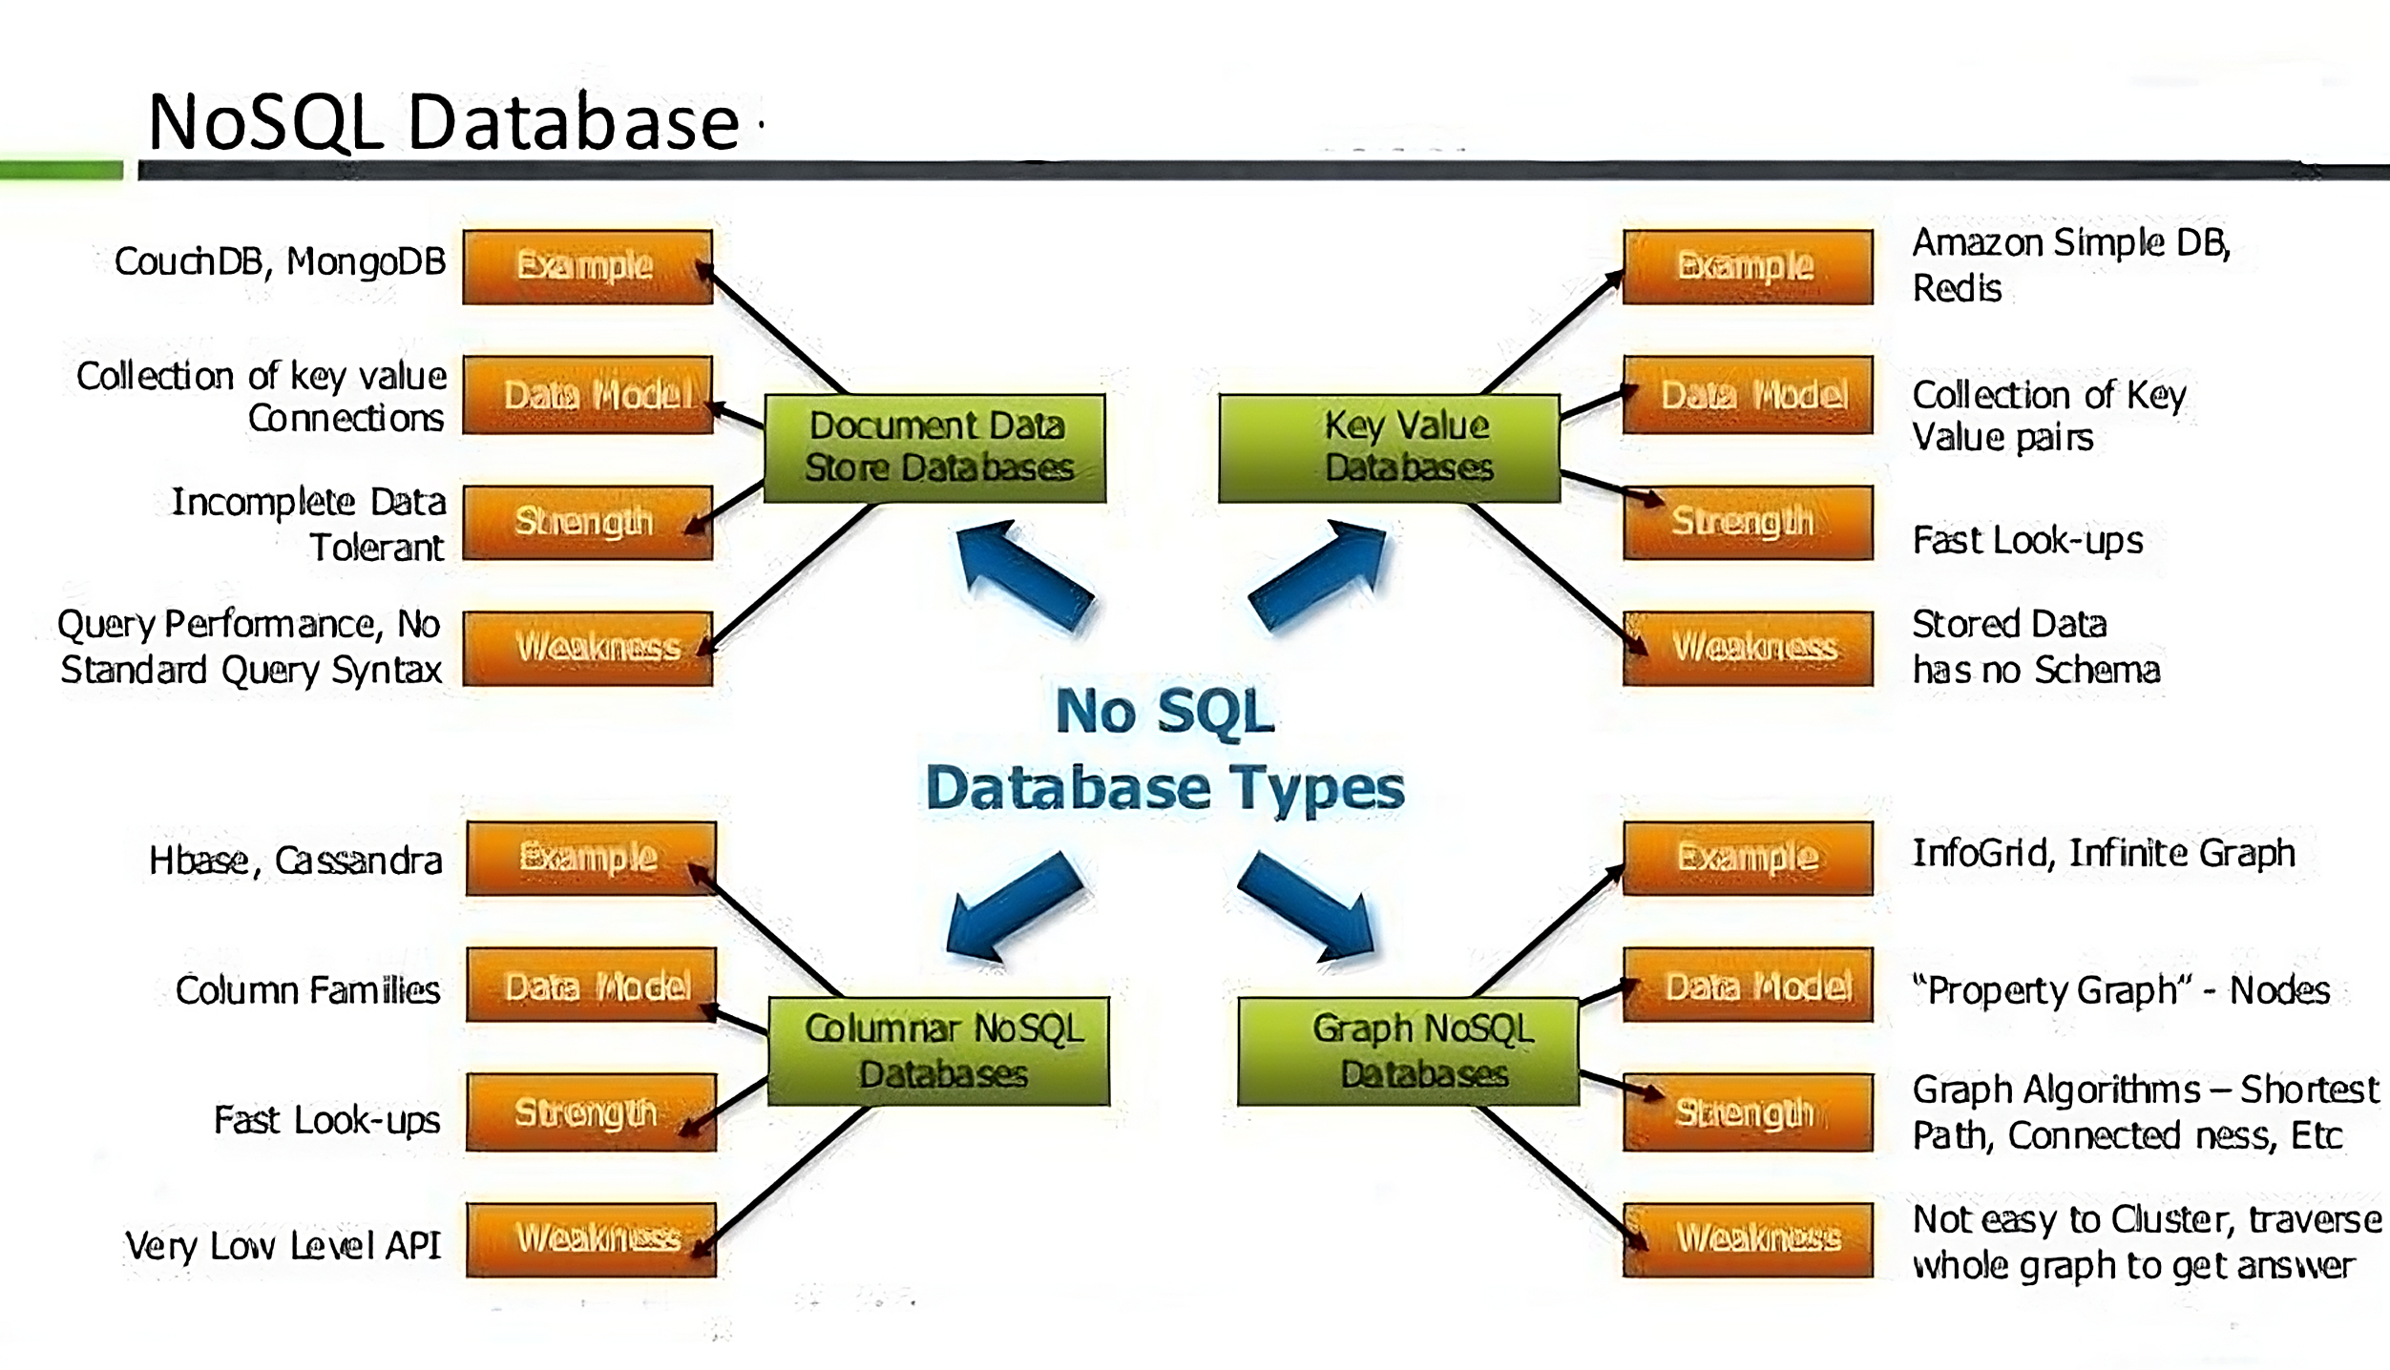
NoSQL Database

Slide 15
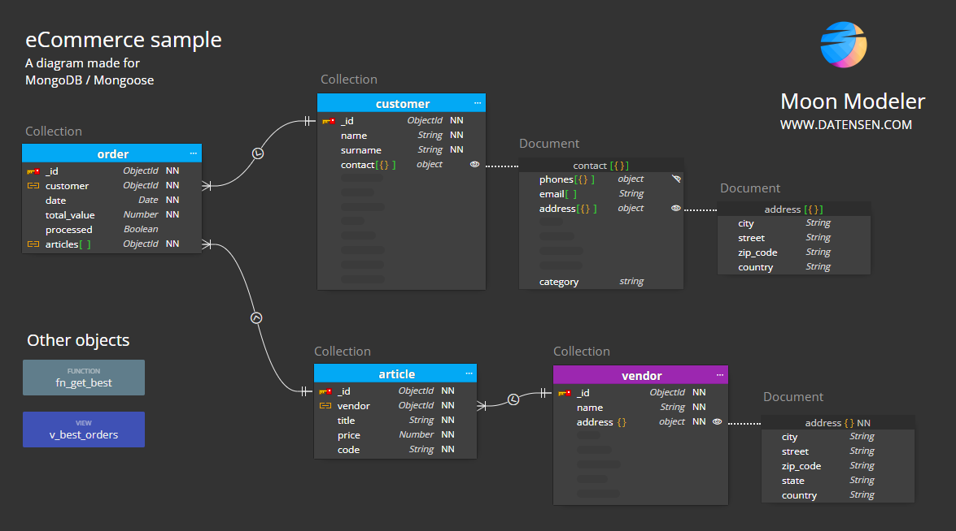
Diagram, MongoDB/Mongoose

Slide 16
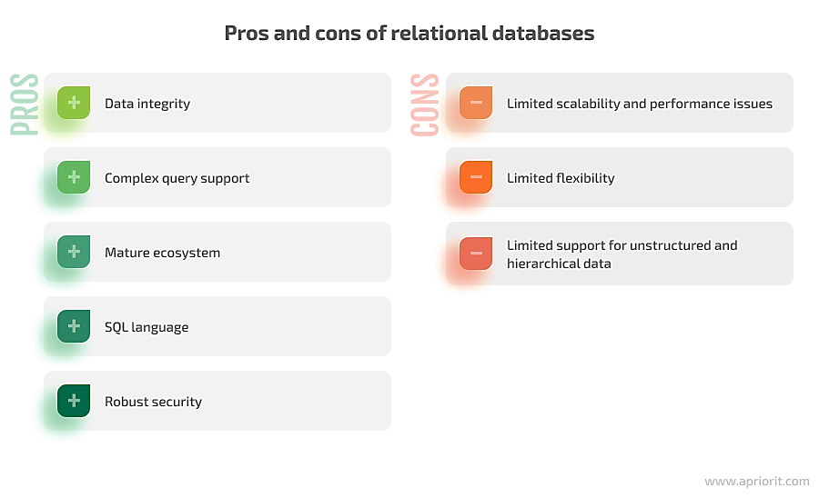
Pros and Cons of Relational Databases

Slide 17
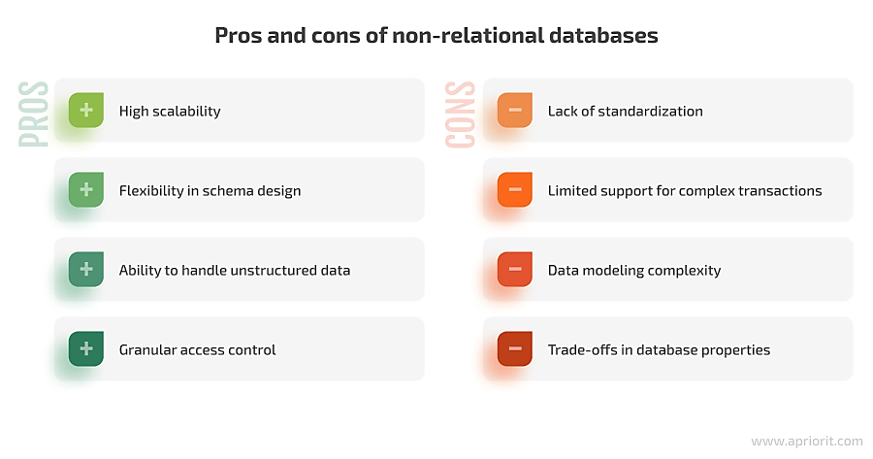
Pros and Cons of Non – Relational database

Slide 18
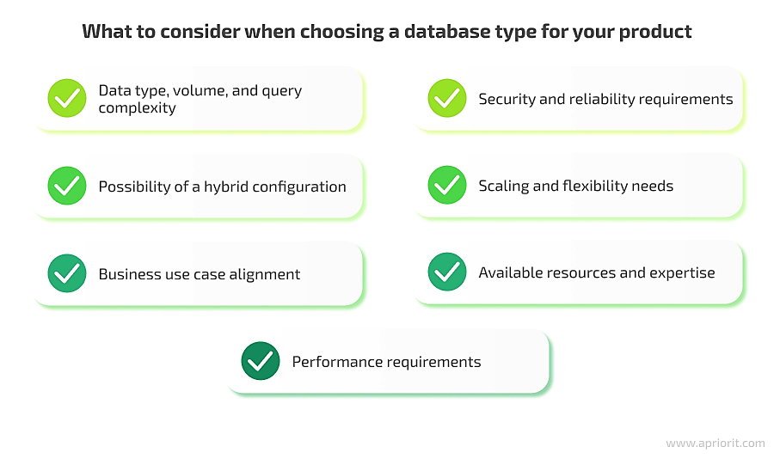
What to consider when choosing a database type for your product

Slide 19
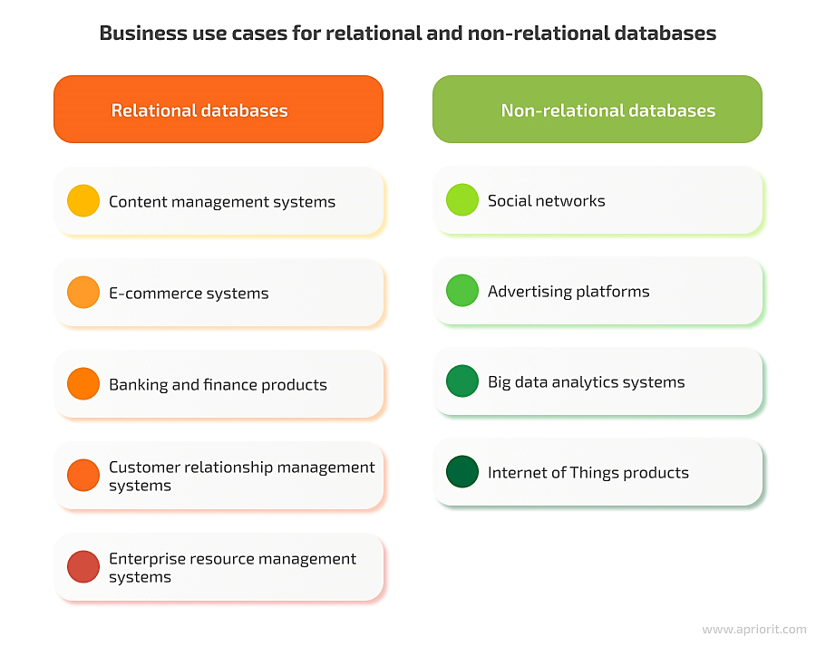
Business Use Cases for Relational and Non-Relational Databases

Slide 20
References
Date, C. J. (2004). "An Introduction to Database Systems." 8th Edition. Addison-Wesley.
Stonebraker, M., & Çetintemel, U. (2005). "One Size Fits All: An Idea Whose Time Has Come and Gone." In Proceedings of the 21st International Conference on Data Engineering.
MongoDB Documentation. (n.d.). "What is NoSQL?" Retrieved from MongoDB
Elmasri, R., & Navathe, S. B. (2015). "Fundamentals of Database Systems." 7th Edition. Pearson.

